Slide 1
General Data Protection Regulation 2018
Canterbury BID
Commitment Without Compromise

Slide 2
GDPR
GDPR are the European regulations which come into effect on 26th May
They replace earlier regulations which are enacted in law in England and Wales by the Data Protection Act 1998
The Data Protection Act 1998 will be replaced by the Data Protection Act 2018, which is currently the Data Protection Bill.
The DPA 2018 means that the GDPR is enacted into UK law and the UK will have comparable legislation post-Brexit.

Slide 3
GDPR
Don’t panic
But take seriously
Penalties

Slide 4
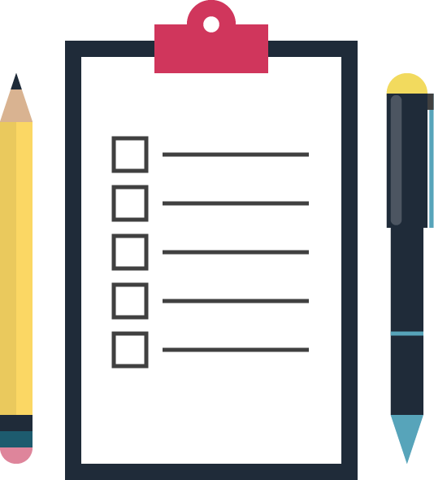
GDPR – Overview
Before we start…..
Data Controller
Data Processor
Data Subject
Personal Data
Special Category Data
or Sensitive Personal Data

Slide 5
GDPR – Overview
The Six (or now Seven?) Principles:
Lawfulness, fairness and transparency
Purpose limitation
Data minimisation
Accuracy
Storage limitation
Integrity and confidentiality
Accountability

Slide 6
GDPR – Overview
Identify lawful basis for processing – which are:
Comply with contract
Satisfy legal obligation
Legitimate interests
Consent
Vital interests
Public tasks

Slide 7
Lawful Basis (ctd)
Vital Interests and Public duty unlikely to apply to most controllers
So to process personal data most controllers will rely on consent, that processing is necessary to perform a contract, that it is necessary to satisfy a legal obligation, or that it is in the legitimate interest of the business.

Slide 8
Consent
Freely Given – so you cannot use consent where there is an imbalance of power such as an employment relationship. GDPR means employers can longer rely on consent.
Specific – consent must be given for a specific activity, so consent cannot be bundled or general
Informed – people must be fully informed of the processing, lawful basis, identity of processor, etc
Unambiguous statement or affirmative action agreeing to processing – so silence, pre-checked boxes or inactivity will not normally constitute consent
Fresh Consent – Exception exists for existing marketing lists where processing the data is in your legitimate interest, the customer’s details were obtained in the course of providing goods or services, and the purpose of the marketing is to provide similar goods or services and the customer has been given the opportunity to opt out

Slide 9
Contract
Lawful basis where you need to process personal information to fulfil your contractual obligations to them.
For example, in an employment context you need to process NI Number and bank details to pay someone.
In a sales context you may need to process name and address and bank details to sell and deliver goods.
But processing must be necessary – you cannot rely on the performance of a contract to market your services.

Slide 10
Legitimate Interests
Most flexible lawful basis, but not always appropriate.
More likely to be appropriate if you are processing data in a way people expect you to and processing has minimal impact on privacy.
You must consider the rights and interests of the data subject against your own
3 stage test:
Is there a legitimate interest?
Is the processing necessary to achieve that interest?
Does it balance against the individual’s interests, rights and freedoms?

Slide 11
Legal Obligation
Lawful basis where you need to process data in order to comply with a legal obligation
For example:
Employers/Landlords to carry out right to work/residence checks
Solicitors, accountants, banks to comply with money laundering regulations
Schools to carry out DBS checks on employees
Employers and PAYE tax payments

Slide 12
Special Category Data
More sensitive – for example information about race, politics, religion, health, sexuality.
GDPR also includes biometric and genetic data
But no longer includes criminal records data (which have a similar but separate protection)
Unlawful processing or data breaches poses a greater risk to the individual
Different, more stringent, lawful basis for processing – including that you cannot rely on legitimate interests (unless you are a charity)
Must have a policy in order to process special category data using the “employment law” purpose set out in the Data Protection Bill.

Slide 13
Criminal Records Data
Under GDPR criminal records can only be processed in a official capacity or as authorised by the member state.
The Data Protection Bill will provide this authorisation if:
It is for the purpose of exercising obligations or rights with regard to employment law and is done in accordance with the employer’s policy; or
The subject has given consent
And then similar rules to processing apply as for special category data

Slide 14
Data Subject Rights
The GDPR provides the following rights for individuals:
The right to be informed
The right of access
The right to rectification
The right to erasure
The right to restrict processing
The right to data portability
The right to object
Rights in relation to automated decision making and profiling.

Slide 15
Information You Hold
Getting your house in order
Under GDPR you must document and maintain records of processing activities.
Information audit / mapping data flows?
Identify and document:
what personal data you hold
its origin,
why you need it
who it is shared with and
what is done with it?

Slide 16
Accountability and Governance
Getting your House in order
Appropriate
Data Protection Policy
Privacy Notices
Data records
Any contracts with data processors and if so are these GDPR compliant?
Processes and procedures for individual rights
Think data protection – integrate
Encryption
Security

Slide 17
Privacy Notices
Getting your House in order
Demonstrate compliance with the principles of fair processing and transparency
Explain what data you process, how you collect it, how you process it, your lawful basis for processing and the subject’s rights.
For example in an employment context:
We will process your NI number
We will obtain it from you during induction
We will store it and pass it to our payroll provider who will process it to calculate our payroll
We process the data in order to meet our legal requirements to pay tax and National Insurance and to perform our contract with you by paying salary
You have the right to be provided with details of the data we hold and to request correction of the data
We will keep the data during the term of your employment and for 6 years afterward

Slide 18
Data Protection Policies
Getting your House in order
Demonstrate compliance with the principles of fair processing and transparency
A requirement if you process sensitive personal data – for example if you employ anyone
Set out your policies with regard to data protection
What data you process (or won’t)
How long you retain it
Who you share it with
How you protect it
What to do in a data breach – notification is a new requirement
Who is responsible for the oversight of data protection
How people can assert their rights and raise concerns

Slide 19
GDPR – practical tips
Special categories – are you processing special category data? Do you have a lawful basis?
Privacy notices – do you have these in place?
Policies and records – do you have these in place?
Sharing data – contracts with third parties
DPO – do you need one, or just a responsible manager?
Security - limit access, encryption, protection

Slide 20
GDPR – practical tips
Assess risks
DPIA
Morrisons and
vicarious liability
Stress test
Data breaches
Obligation to report
Training

Slide 21
GDPR – practical tips
Prepare
Be aware of scope
30 days, but scope for extension
Exemptions to disclosure

Slide 22
Registration
Key Points
Are you registered with ICO? Many businesses will need to register – CCTV use is one of the requirements.
Post May 2018 – data protection fee - £35 (except for large businesses)

Slide 23
Questions?
David Morgan
davidmorgan@girlings.com
01233 664711

Slide 24
girlings.com

